Slide 1
Week 8
Overcoming Objections
第八周
克服异议

Slide 2
Professional Language and Handling Questions and Objections
使用专业语言来处理问题及异议
Learn the language of Market America
学习美安事业的专业用语

Slide 3
Don’t be lazy with your words
不要简述说话的词句

Slide 4
不要这样说
Don’t say this
而应这样说
Instead say this
我加入美安公司
I JOINED Market America
我开始了我自己的事业
I started my own business
我是美安公司的一个成员
I’m a member of Market America
我拥有自己的事业
I own a business
我做美安
I do Market America
我是为自己工作
I work for myself
星期二晚有一场UBP会议
There’s a UBP meeting Tuesday night
星期二晚会有一场创业说明会
There is a business presentation Tuesday night

Slide 5
不要这样说
Don’t say this
而应这样说
Instead say this
我左右各达到1200，得到我的第一张支票
I hit 1200 and 1200 and got my first cheque
我已赚取我的第一份佣金
I earned my first commission
我的推荐人名字叫Dan
My sponsor’s name is Dan
我的事业伙伴名字叫Dan
My business partner’s name is Dan
我想请您见见我的上线
I want you to meet the people in my upline
我想请您见见我的事业伙伴
I want you to meet my business partners
我已有下线
I already have people below me
我的事业正在成长
My business is already growing

Slide 6
不要这样说
Don’t say this
而应这样说
Instead say this
我合作的伙伴刚在一个月之内赚取佣金超过10,000
The person I am working with has exceeded USD10,000 in a month in commissions
我合作的伙伴是个总顾问经理级
The person I am working with is a National Supervising Coordinator
什么时间您想登记/加入？
When do you want to sign-up/get in?
什么时间您会愿意开始/登记您的事业？
When would you like to start/register your business?
请造访我的 SHOP.COM 入门网站
Check out my SHOP.COM portal.
请造访我的 SHOP.COM 网站
Check out my SHOP.COM website.

Slide 7
Overcoming Objections （克服异议）
Objections simply say No, Not Now, Not interested or it can be a way to test us.
当人们拒绝我们时，其实他们也在找借口，可能时机不对，可能没有兴趣；又或者是在考验我们！

Slide 8
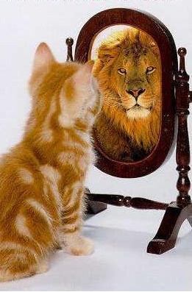
Posture! 姿态
Posture! 姿态 Posture! 姿态

Slide 9
TIPS 小贴士
Reply with a Question to a Question
常用问题来回答另一个问题
Don’t rush into defensive mode
不要急于反击
If don’t know: Great Question. I will find out and
get back to you.
如果不会，你可以说：“那是一个很好的问题。我会请教资深伙伴后给你回复。”
Leverage Senior Partner help
借力于资深伙伴

Slide 10
不是 NO
这算是金字塔计划吗？
Is this a pyramid?
金字塔计划是非法的 Pyramids are illegal
金字塔计划是赚佣金只靠不断拉人加入，不靠销售产品
A pyramid pays for recruiting instead of being based on product sales
美安事业是一个合法的事业，自1992年以来，有成功的记录可证明。
This is a legitimate business with a proven track record since 1992
商业信誉局(Better Business Bureau) 给予美安公司A+评级
A+ rating from the Better Business Bureau
每家公司其实都有多层结构。
Every corporation’s organizational structure resembles a pyramid
什么是金字塔计划？ What is a pyramid?

Slide 11
Is this Amway?
is this multi-level marketing?
这是安丽吗？ 这是多层次行销吗？
No
没有
What has been your experience with (Amway or multi-level marketing)?
您参加过（安丽或多层次营销）吗？
We took the best of franchising and networking and eliminated the flaws
我们吸收了连锁店和网络营销的优点，但去除这两者的缺点。

Slide 12
MA 美安 vs MLM 多层次行销
Market America
Multi-Level Marketing
Binomial System, Vertical Marketing 双轨、垂直性行销
100% Infinity from the bottom up 100%无限代借力
BV=365 days, IBV=365 days 业绩点数=365天,奖励业绩点数=365天
Buy products from Company 向公司买产品
Paid Weekly 佣金以周期计算
Need only 2 good partners 需要 2 位要创业的领导
5000 Cap 5000 点峰顶
2-3 yrs part-time 2-3 年计划
Product Brokerage Company 产品代理公司
GMTSS (open- house) 全球会议联盟系统
MPCP never change in 20 yrs 红利计划在20 年内从没有更换过
Polynomial, Multiply: Horizontal
多层次：横行行销
Depending % of which level 不同层次给予不同的佣金
Majority 30 days ex: Amway 30天零零
Buy products from uplines & uplines make retail profit 向上线买货，上线赚取零售
Paid Monthly 佣金以月份计算
Can not stop recruitin 不能停止招募
No Cap 没有峰顶
Can never Stop 不能停止
Limited Products ex. Mary Kay 产品种类有限
Not Welcome to others 不被受欢迎
MLM companies change and copy (Unstable) 公司常常更换条例不稳

Slide 13
我没空
I just don’t have any time
先认同他们的说法再接着说：
「是啊…今天大家好像都很忙，没空…」
Acknowledge the comment and follow with: “Today, no one seems to have time with _____”
先认同他们的说法再接着说：「我们来喝杯咖啡好不好？您可能会认识一些合适的人选，这会对我有帮助。」
Agree with the comment and follow with: “Can we get together for coffee? I could use your help and you may know the right people.”
「赚取额外收入可为您带来更多自由支配的时间。」
“The additional income generated could help create more free time.”

Slide 14
我没钱
I just don’t have the money
如果您有兴趣，但只是因为没钱而不能参与，我们先来销售一些产品便可以赚取收入。
If you are interested and money is the only thing holding you back, let’s set up a product event and generate some sales.
我们会与您及您认识的人一起做。如我们能找到合适的人选，这样就有回报了。
We’ll do the work with you and run it by people you know. If we can find you the right people, then it’s already profitable.

Slide 15
I have to talk with my spouse
我需要跟我的另一半商量
That’s a great idea, would it be possible for the three of us to get together?
好主意，让我和您们夫妻俩聊聊，您看什么时候方便？

Slide 16
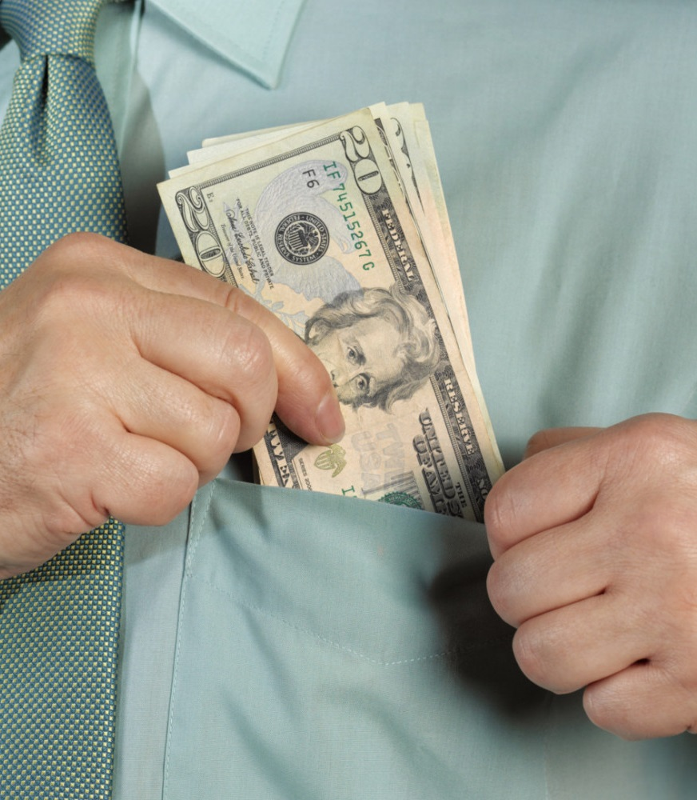
If you are NEW如您最近才加入事业
我刚刚开始做这个事业
I am just getting started
我已经赚回起步所需的开支
I already made my initial start up cost back
我正在开始赚钱…
I am on my way to earning
我已在赚取零售利润，并朝着赚取佣金的方向迈进
I am already earning retail profits, and I am on my way to earning commissions
How much are you earning? Are you making any money yet?
「您现在赚多少？」 「您现在赚到钱了吗？」
If you are NOT new 如您加入事业已有一段时间
起初我只是赚取零售利润，现在我正在发展我的团队并赚取佣金。
Initially I was earning retail profits, now I am expanding my team and earning commissions

Slide 17
让我考虑一下
Let Me Think About It
好吧，我们在几天后再见面来回答您的任何问题。现在我们来约定一个会面时间吧！
Great, let’s get back together in a couple of days to answer any questions you come up with. Let’s schedule the appointment now.
好吧，评估美安马来西亚事业的一个好方法就是参加美安马拉西亚培训活动。（向他们售买门票）
Great, one of the best ways to evaluate our business is to attend one of our trainings. (sell them a ticket)
好吧，在您考虑的期间，您可以试试我们的独家品牌产品。
Great, while you are thinking about it why don’t you try one of our exclusive products.

Slide 18
我需要作销售吗？
Do I Have To Sell Anything？
Yes. This is a business
没错， 这是一个事业
People love our products and find it easy to talk about them
人们喜欢我们的产品，因此与他们谈论产品较为容易
SHOP.COM pays people Cashback on purchases when they shop at their favorite online stores
人们透过 SHOP.COM 在自己喜爱的线上商店购物，可以获得现金反馈

Slide 19
I’m not interested
我没有兴趣
Before seeing the plan
在看到美安马来西亚计划之前
I wasn’t sure if you would be. Could we get still get together because you may know the right people and I would appreciate your help.
您有没有兴趣现在还不好说定。我们是否可以聚一聚？如果您认识一些适合这事业的人选，我会很感谢您的帮忙。

Slide 20
I’m not interested
我没有兴趣
After seeing the plan
看过美安马来西亚计划之后
Timing may not be right for you now.
Would you mind if I stay in touch?
也许现在这时候您不方便。改天再与您联络怎么样？
No problem, would you be interested in trying some products or referring some people that may be interested?
没问题，您是否有兴趣试用一些产品或推荐一些对此有兴趣的人？

Slide 21
FINAL TIPS 最终的贴士
Learn How To Show The Plan! 学习如何展示计划！
MAM 会后会
Don’t be Weird 不要做出奇异的动作
No means LATER 《不要》的意思就是不是时候
Take Action! 要执行！
Have fun! 要轻松！
Never Give Up! 不要容易被屈服！

